Slide 1

Subject: FUNDAMENTALS Of iOS APPLICATION DEVELOPMENT WITH SWIFT
Module Number - 4
Module Name: Autolayouts & StackViews

Slide 2
Autolayouts & StackViews
Syllabus
Optionals
Type Casting
Guard
Introduction to Autolaytouts & SatckViews
Constraints
Alignment Rect
Content Size
Auto Layout Features
Visual Cues
Aspect Ratio Constraints
Size Classes

Slide 3
Autolayouts & StackViews
AIM:
To understand the concept’s of Designing Universal App, Auto layouts & StackViews, Auto layouts Features & Size Classes.

Slide 4
Autolayouts & StackViews
Objectives:
Study and understand the concepts of Universal App Design
Auto Layouts & StackViews
Auto Layouts Features
Constraints
Size Classes

Slide 5
Autolayouts & StackViews
Table of Contents:
Optionals
Type Casting
Guard
Introduction to Autolaytouts & SatckViews
Constraints
Alignment Rect
Content Size
Auto Layout Features
Visual Cues
Aspect Ratio Constraints
Size Classes

Slide 6
Optionals
Autolayouts & StackViews
Introducing optionals
When we declare variables in Swift, they are by default non-optional, which means that they must contain a valid, non-nil value. If we try to set a non-optional variable to nil, it will result in an error.
For example, the following code will throw an error when we attempt to set the message variable to nil because it is a non-optional type:
var message: String = "My String"
message = nil
It is very important to understand that nil in Swift is very different from nil in ObjectiveC or other C-based languages. In these languages, nil is a pointer to a non-existent object; however, in Swift a nil value is the absence of a value. This concept is very important to fully understand optionals in Swift.
A variable defined as an optional can contain a valid value or it can indicate the absence of a value. We indicate the absence of a value by assigning it a special nil value. Optionals of any type can be set to nil, whereas in Objective-C, only objects can be set to nil.

Slide 7
Autolayouts & StackViews
To really understand the concept behind optionals, let's look at a line of code that defines an optional:
var myString: String?
The question mark at the end indicates that the myString variable is an optional. We read this line of code as saying that the myString variable is an optional type, which may contain a value of the string type or may contain no value.
Defining an optional
One thing to keep in mind is that the type we define in the variable's declaration is actually the associated value in the optional enumeration. The following code shows us how we would typically declare an optional:
var myOptional: String?
This code declares an optional variable that might contain a string or might contain no value. When a variable such as this is declared, by default it is set to nil.
Using optionals
The key to using optionals is to always verify that they contain a valid value prior to accessing them. We use the term unwrapping to refer to the process of retrieving a value from an optional.

Slide 8
Autolayouts & StackViews
Forced unwrapping of an optional
To unwrap or retrieve the value of an optional, we place an exclamation mark (!) after the variable name. This is called forced unwrapping. Forced unwrapping, in this manner, is very dangerous and should be used only if we are certain that the variable contains a nonnil value. Otherwise, if it does contain a nil value, we will get a runtime error and the application will crash.
When we use the exclamation point to unwrap an optional, we are telling the compiler that we know the optional contains a value, so go ahead and give it to us. Let's look at how to do this:
var myString1: String?
myString1 = "test"
var test: String = myString1!
This code will work as we expect it to, where the test variable will contain the "test" string; however, if the line that set the myString1 optional to test were removed, we would receive a runtime error when the application is run. Note that the compiler will not alert us to an issue because we are using the exclamation point to unwrap the optional, therefore, the compiler assumes that we know what we are doing and will happily compile the code for us. We should verify that the myString1 optional contains a valid value prior to unwrapping it. The following example is one way to do this:
var myString1: String?
myString1 = "test"
if myString1 != nil {
var test = myString1!
}

Slide 9
Autolayouts & StackViews
Now, if the line that sets the myString1 optional to test were removed, we would not receive a runtime error because we only unwrap the myString1 optional if it contains a valid (non-nil) value.
Unwrapping optionals, as we just described, is not optimal, and it is not recommended that optionals be unwrapped in this manner. We can combine verification and unwrapping in one step, called optional binding.
Optional binding
Optional binding is the recommended way to unwrap an optional. With optional binding, we perform a check to see whether the optional contains a valid value and, if so, unwrap it into a temporary variable or constant. This is all performed in one step.
Optional binding is performed with the if or while conditional statements. It takes the following format if we want to put the value of the optional in a constant:
if let constantName = optional {
statements
}
If we need to put the value in a variable, instead of a constant, we can use the var keyword, as shown in the following example:
if var variableName = optional {
statements
}

Slide 10
Autolayouts & StackViews
The following example shows how to perform optional binding:
var myString3: String?
myString3 = "Space, the final frontier"
if let tempVar = myString3 {
print(tempVar)
} else {
print("No value")
}
In the example, we define the myString3 variable as an optional type. If the myString3 optional contains a valid value, the new variable, named tempvar, is set to that value and is printed to the console. If the myString3 optional does not contain a value, No value is printed to the console.

Slide 11
Type Casting
Autolayouts & StackViews
Type casting is a way to check the type of an instance, or to treat that instance as a different superclass or subclass from somewhere else in its own class hierarchy.
Type casting in Swift is implemented with the is and as operators. These two operators provide a simple and expressive way to check the type of a value or cast a value to a different type.
Swift must always know the type of each of your variables, but sometimes you know more information than Swift does. For example, here are three classes:
class Animal { }
class Fish: Animal { }
class Dog: Animal {
func makeNoise() {
print("Woof!")
}
}

Slide 12
Autolayouts & StackViews
We can create a couple of fish and a couple of dogs, and put them into an array, like this:
let pets = [Fish(), Dog(), Fish(), Dog()]
Swift can see both Fish and Dog inherit from the Animal class, so it uses type inference to make pets an array of Animal.
If we want to loop over the pets array and ask all the dogs to bark, we need to perform a typecast: Swift will check to see whether each pet is a Dog object, and if it is we can then call makeNoise().
This uses a new keyword called as?, which returns an optional: it will be nil if the typecast failed, or a converted type otherwise.
Here’s how we write the loop in Swift:
for pet in pets {
if let dog = pet as? Dog {
dog.makeNoise()
}
}

Slide 13
Guard
Autolayouts & StackViews
Swift Guard Statement
The main use of guard statement is to transfer program control out of a scope on certain conditions. These statements are similar with if statements which executes statements based on certain condition (boolean value) but unlike if, the guard statements only run when certain conditions are not met.
Moreover, statements inside the guard must exit from the scope. Therefore, we have to user program control statements return, break, continue or throw at the end of the guard statement.
Syntax of Guard Statement
guard expression else {
//statements
//must contain a control statement: return, break, continue or throw.
}
Here, expression is a boolean expression (returns either true or false).
If the expression is evaluated to false, statements inside the code block of guard is executed.
If the expression is evaluated to true, statements inside the code block of guard are skipped from execution.

Slide 14
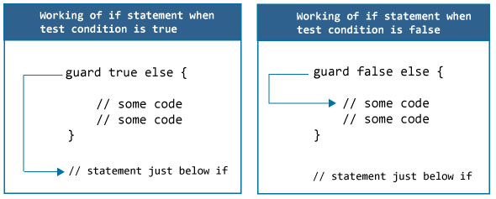
Autolayouts & StackViews
How guard statement works?
Note: The end of the guard statement must contain a control statement return, break, continue or throw.

Slide 15
Autolayouts & StackViews
Example 1: How guard statement works?
A simple valid guard statement is as below:
guard true else {
print("Condition not met")
}
print("Condition met")
When you run the program, the output will be:
Condition met
In the above program, guard contains a boolean value true (condition is met). Since, guard statements only run when the condition is not met, the statement inside the guard is not executed. That's why print("Condition met") is executed and outputs Condition met on the screen.
Now let's change the condition to false as:

Slide 16
Autolayouts & StackViews
Example 2: guard statement has to exit the scope
guard false else {
print("Condition not met")
}
print("Condition met")
In the above program, the guard condition evaluates to false. So, the statement print("Condition not met") inside else should execute. But you will get an error saying 'guard' body may not fall through, consider using a 'return' or 'throw' to exit the scope.
The error message in simple word means, you need to transfer program control from the guard statement using return, break, continue or throw statements. For now we are going to use return. And since return statement can be used only inside a function, we are going to wrap above code in Swift Functions.

Slide 17
Autolayouts & StackViews
Example 3: guard statement inside a function
We can use the guard statement inside in a function in Swift as:
func someFunction() {
guard false else {
print("Condition not met")
return
}
print("Condition met")
}
someFunction()
print("Hello after function call")
When you run the above program, the output will be:
Condition not met
Hello after function call

Slide 18
Autolayouts & StackViews
In the above program, the guard condition evaluates to false, therefore the statements inside the guard executes. The first statement print("Condition not met") outputs Condition not met in the console.
And the statement return terminates execution of a function and the statement print("Hello, after function call") after the function call executes which outputs Hello after function call in the console.

Slide 19
Introduction to Auto Layouts
Autolayouts & StackViews
Auto layout is a constraint-based layout system. It allows developers to create an adaptive UI that responds appropriately to changes in screen size and device orientation.
Some beginners find it hard to learn. Even some developers avoid using it. But believe me, you won't be able to live without it when developing an app today.
When iPhone was first released over ten years ago, it only came with a single screen size: 3.5-inch. Later we had the 4-inch iPhone. In September 2014, Apple introduced the iPhone 6 and 6 Plus.
Now Apple's iPhones are available in different screen sizes including 3.5-inch, 4-inch, 4.7-inch, 5.5-inch, 5.8-inch, 6.1-inch, and 6.5-inch displays. When you design your app UI, you have to cater for all these screen sizes.

Slide 20
Autolayouts & StackViews
If your app is going to support both iPhone and iPad (also known as a universal app), you will need to make sure the app fits additional screen sizes including 7.9-inch, 9.7-inch, 10.5-inch, and 12.9-inch.
Without using auto layout, it would be very hard for you to create an app that supports all screen resolutions.

Slide 21
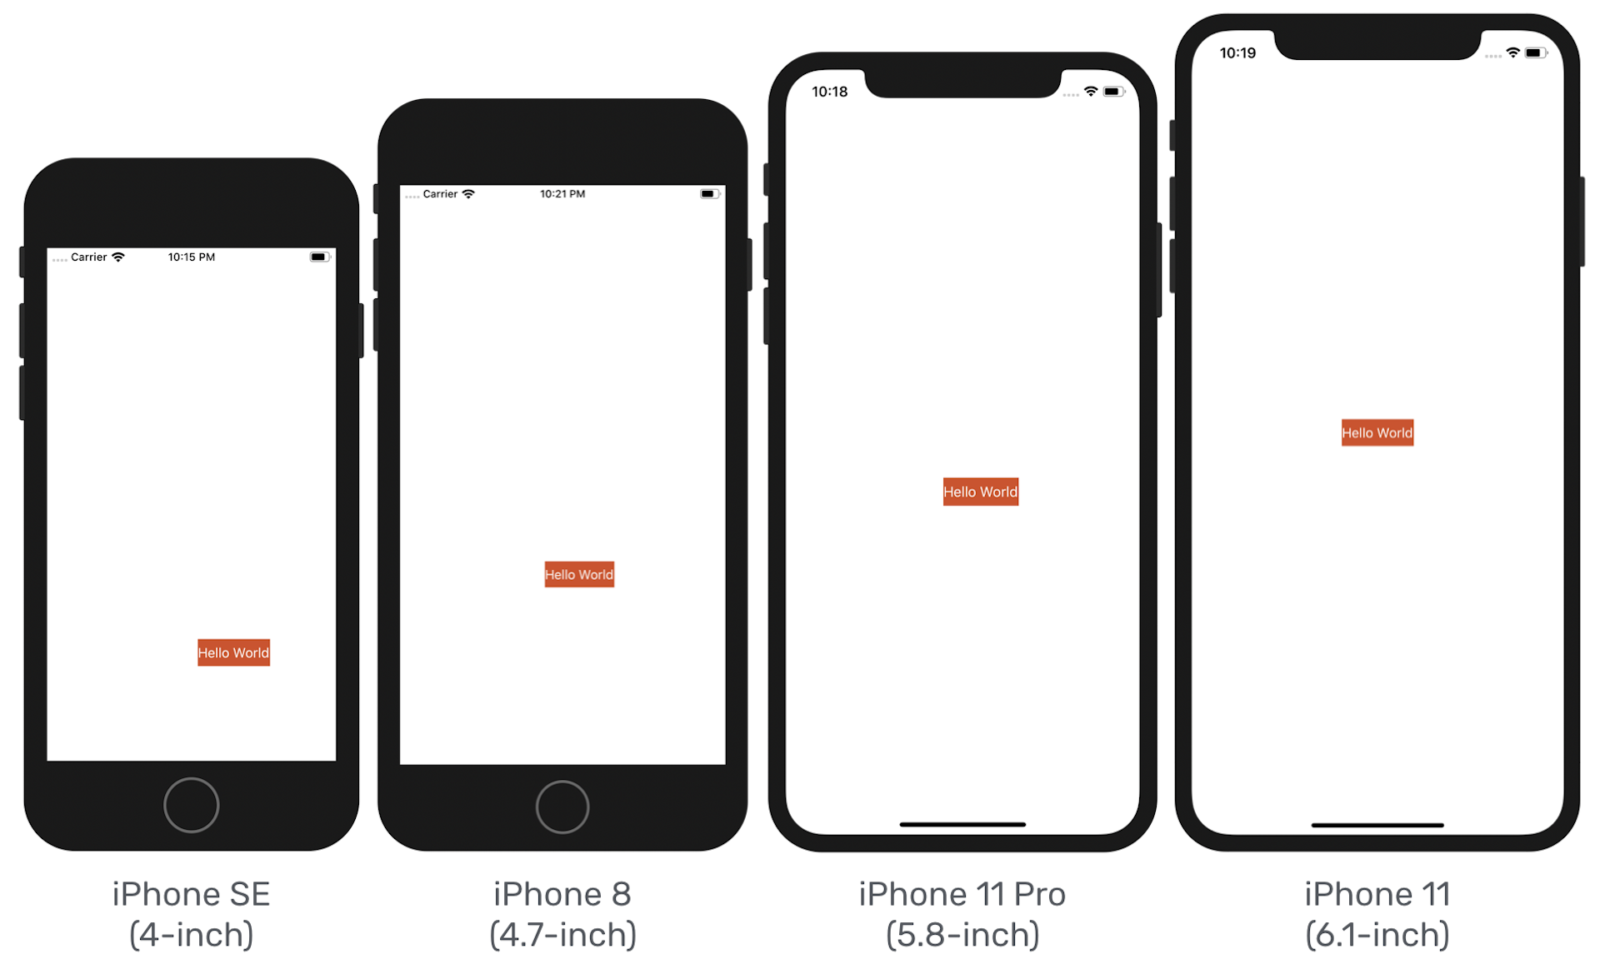
Autolayouts & StackViews
Why Auto Layout?
Figure: The app UI looks different when running on iPhone SE, iPhone 8, iPhone 11 and iPhone 11 Pro

Slide 22
Autolayouts & StackViews
As you know, the iPhone devices have different screen dimensions:
For iPhone 5/5s/SE, the screen in portrait mode consists of 320 points (or 640 pixels) horizontally and 568 points (or 1136 pixels) vertically.
For iPhone 6/6s/7/8, the screen consists of 375 points (or 750 pixels) horizontally and 667 points (or 1334 pixels) vertically.
For iPhone 6/6s/7/8 Plus, the screen consists of 414 points (or 1242 pixels) horizontally and 736 points (or 2208 pixels) vertically.
For iPhone X/XS/11 Pro, the screen consists of 375 points (or 1125 pixels) horizontally and 812 points (or 2436 pixels) vertically.
For iPhone XR/11, the screen consists of 414 points (or 828 pixels) horizontally and 896 points (or 1792 pixels) vertically.
For iPhone XS Max/11 Pro Max, the screen consists of 414 points (or 1242 pixels) horizontally and 896 points (or 2688 pixels) vertically.
For iPhone 4s, the screen consists of 320 points (or 640 pixels) and 480 points (or 960 pixels).

Slide 23
Autolayouts & StackViews
Why Points instead of Pixels?
Back in 2007, Apple introduced the original iPhone with a 3.5-inch display with a resolution of 320x480. That is 320 pixels horizontally and 480 pixels vertically.
Apple retained this screen resolution with the succeeding iPhone 3G and iPhone 3GS. Obviously, if you were building an app at that time, one point corresponds to one pixel.
Later, Apple introduced iPhone 4 with retina display. The screen resolution was doubled to 640x960 pixels. So one point corresponds to two pixels for retina display.
The point system makes our developers' lives easier. No matter how the screen resolution is changed (say, the resolution is doubled again to 1280x1920 pixels), we still deal with points and the base resolution (i.e. 320x480 for iPhone 4/4s or 320x568 for iPhone 5/5s/SE). The translation between points and pixels is handled by iOS.

Slide 24
Autolayouts & StackViews
Without using auto layout, the position of the button we lay out in the storyboard is fixed. In other words, we "hard-code" the frame origin of the button.
In our example, the "Hello World" button's frame origin is set to (147, 318). Therefore, whether you're using a 4.7-inch or 5.5-inch or 5.8-inch simulator, iOS draws the button in the specified position. Figure illustrates the frame origin on different devices.
This explains why the "Hello World" button can only be centered on iPhone 11, and it is shifted away from the screen center on other iOS devices, as well as, in landscape orientation.

Slide 25
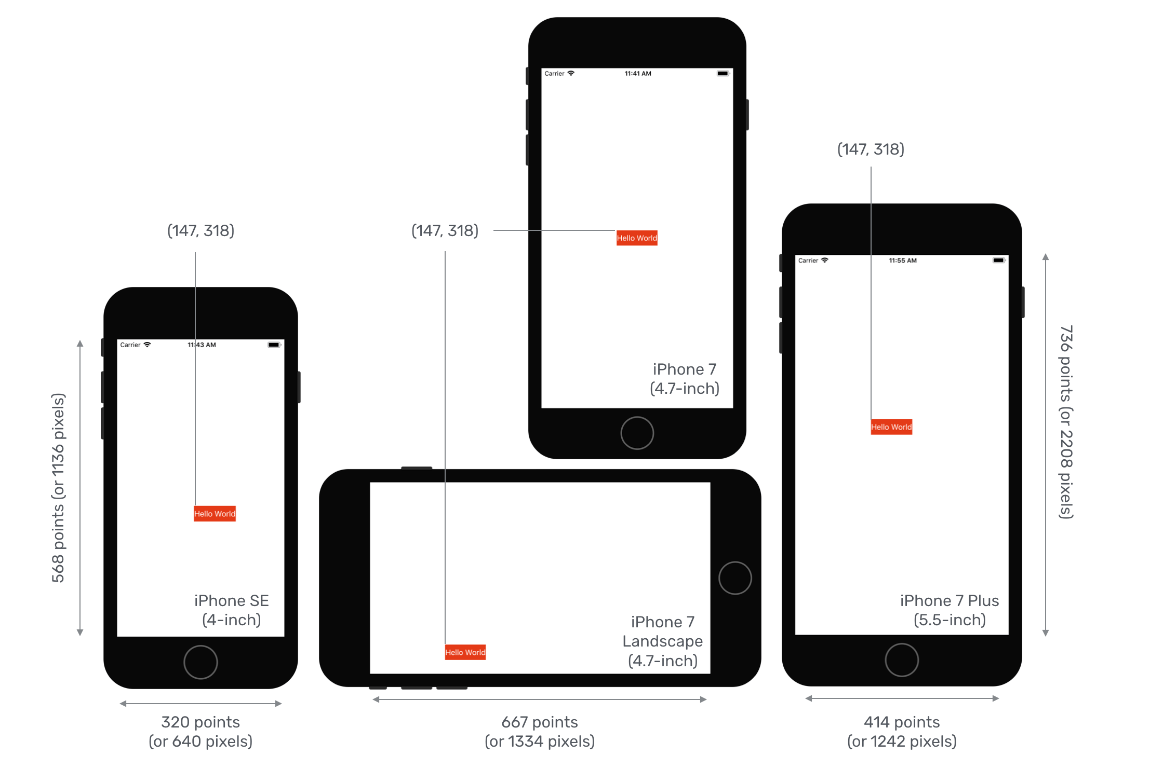
Autolayouts & StackViews
Obviously, we want the app to look good on all iPhone models, and in both portrait & landscape orientation. This is why we have to learn auto layout. It's the answer to the layout issues, that we have just talked about.

Slide 26
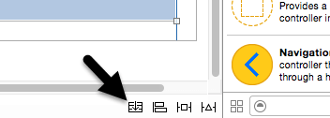
Introduction to StackViews
Autolayouts & StackViews
The UIStackView class is a user interface element that allows subviews to be arranged linearly in either a column or row orientation. The class makes extensive use of Auto Layout and automatically sets up many of the Auto Layout constraints needed to provide the required layout behavior. The class goes beyond simple stacking of views, allowing additional Auto Layout constraints to be added to subviews, and providing a range of properties that enable the layout behavior of those subviews to be modified to meet different requirements.
The UIStackView object is available for inclusion with Storyboard scenes simply by dragging and dropping either the Horizontal Stack View or Vertical Stack View from the Object Library onto the scene canvas. Once added to a scene, subviews are added simply by dragging and dropping the required views onto the stack view.
Existing views in a storyboard scene may be wrapped in a stack view simply by Shift-clicking on the views so that they are all selected before clicking on the Stack button located in the bottom of the Interface Builder panel as highlighted in Figure. Interface Builder will decide whether to encapsulate the selected views into a horizontal or vertical stack depending on the layout positions of the views:

Slide 27
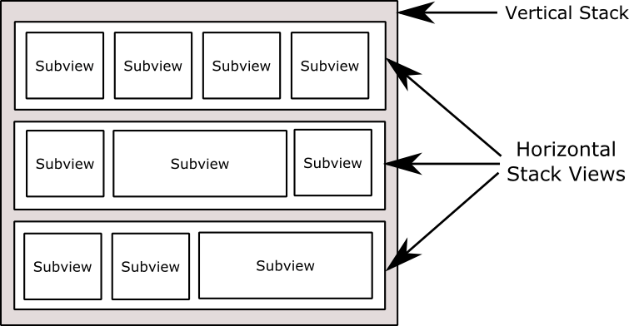
Autolayouts & StackViews
By default the stack view will resize to accommodate the subviews as they are added. As with any other view type, however, Auto Layout constraints may be used to constrain and influence the resize behavior of the stack view in relation to the containing view and any the other views in the scene layout.
Once added to a storyboard scene, a range of properties are available within the Attributes Inspector to customize the layout behavior of the object.
Stack views may be used to create simple column or row based layouts, or nested within each other to create more complex layouts. Figure, for example, shows an example layout consisting of a vertical stack view containing 3 horizontal stack views each containing a variety of subviews:

Slide 28
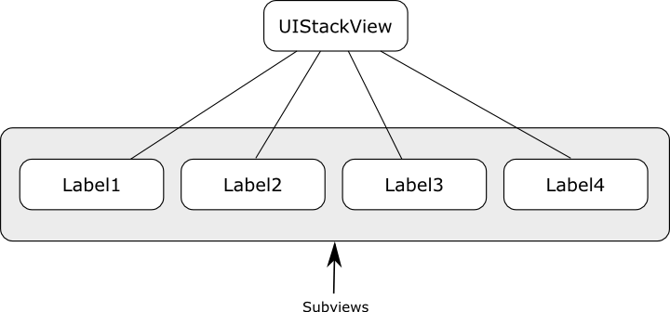
Autolayouts & StackViews
UIStackView class instances may also be created and managed from within the code of an iOS app. Stack view instances can be created in code and initialized with an array of subviews. Views may also be inserted and removed dynamically from within code and the attributes of the stack view changed via a range of properties. The subviews of a stack view object are held in an array which can be accessed via the arrangedSubviews property of the stack view instance.
Understanding Subviews and Arranged Subviews
The UIStackView class contains a property named subviews. This is an array containing each of the child views of the stack view object. In below Figure for example shows the view hierarchy for a stack view with four subviews:

Slide 29
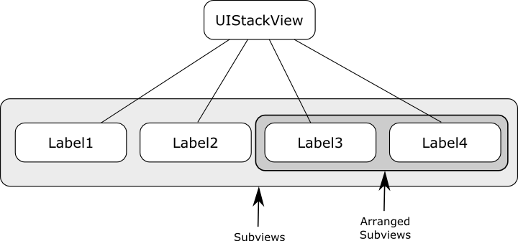
Autolayouts & StackViews
At any particular time, however, the stack view will not necessarily be responsible for arranging the layout and positions of all of the subviews it contains. The stack view might, for example, only be configured to arrange the Label3 and Label4 views in the above hierarchy. This essentially means that Label1 and Label2 may still be visible within the user interface but will not be positioned within the stack view. Subviews that are being arranged by the stack view are contained within a second array which is accessible via the arrangedSubviews property. Figure 31-4 shows both the subviews and the subset of the subviews which are currently being arranged by the stack view.

Slide 30
Autolayouts & StackViews
As will be outlined later in this chapter, the distinction between subview and arranged subviews is of particular importance when removing arranged subviews from a stack view.
StackView Configuration Options
A range of options are available to customize the way in which the stack view arranges its subviews. These properties are available both from within the Interface Builder Attributes Inspector panel at design time and also to be set dynamically from within the code of the app:
axis
The axis property controls the orientation of the stack in terms of whether the subviews are arranged in a vertical column layout or a horizontal row. When setting this property in code the axis should be set to UILayoutConstraintAxisVertical or UILayoutConstraintAxisHorizontal.

Slide 31
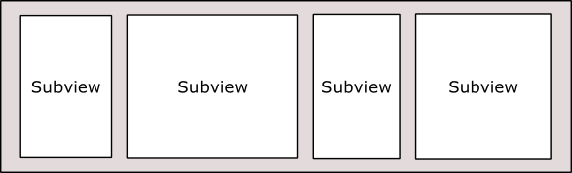
Autolayouts & StackViews
Distribution
The distribution property dictates the way in which the subviews of the stack view are sized. Options available are as follows:
Fill – The subviews are resized so as to fill the entire space available along the axis of the stack view. In other words the height of the subviews will be modified to fill the full height of the stack view in vertical orientation while the widths will be changed for a stack view in horizontal orientation. The amount by which each subview is resized relative to the other views can be controlled via the compression resistance and hugging priorities of the views and the position of the views in the stack view’s arrangedSubviews array.

Slide 32
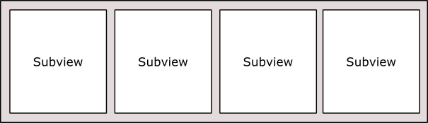
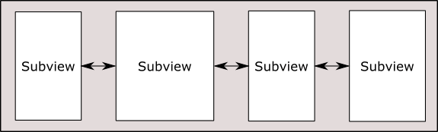
Autolayouts & StackViews
FillEqually – The subviews are resized equally to fill the stack view along the view’s axis. In a vertical stack, therefore, all of the subviews will be of equal height whilst in a horizontal axis orientation the subviews will be of equal width.
FillProportionally – In this mode, the subviews are resized proportionally to their intrinsic content size along the axis of the stack view to fill the width or height of the view.
EqualSpacing – Padding is used to space the subviews equally to fill the stack view along the axis. The size of the subviews will be reduced if necessary in order to fit within the available space based on the compression resistance priority setting and the position within the arrangedSubviews array.

Slide 33
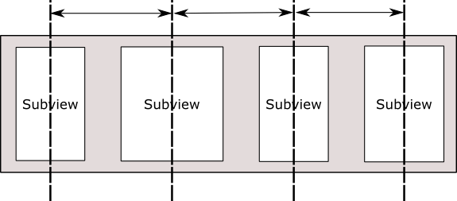
Autolayouts & StackViews
EqualCentering – This mode tries to position the subviews along the stack view’s axis such that the views have equal center to center spacing. The spacing used in this mode is influenced by the spacing property (outlined below). Where possible the stack view will honor the prevailing spacing property value, but will reduce this value if necessary. If the views still do not fit, the size of the subviews will be reduced if necessary in order to fit within the available space based on the compression resistance priority setting and the position within the arrangedSubviews array.

Slide 34
Autolayouts & StackViews
spacing
The spacing property specifies the distance (in points) between the edges of adjacent subviews within a stack view. When the stack view distribution property is set to FillProportionally the spacing value dictates the spacing between the subviews. In EqualSpacing and EqualCentering modes, the spacing value indicates the minimum allowed spacing between the adjacent edges of the subviews. A negative spacing value causes subviews to overlap.

Slide 35
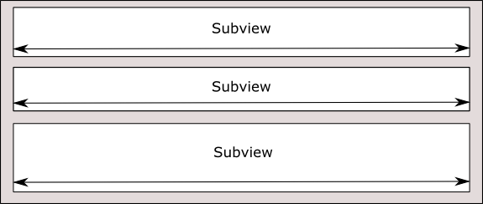
Autolayouts & StackViews
alignment
The alignment property controls the positioning of the subviews perpendicularly to the axis of the stack view. Available alignment options are as follows:
Fill – In fill mode, the subviews are resized to fill the space perpendicularly to the stack view’s axis. In other words, the width of the subviews in a vertical stack view are resized to fill the full width of the stack view.

Slide 36
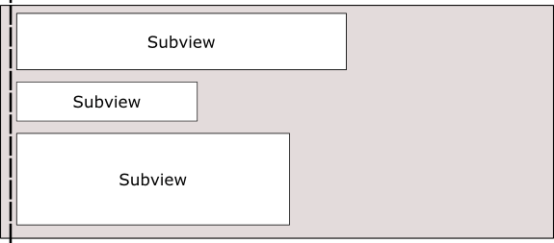
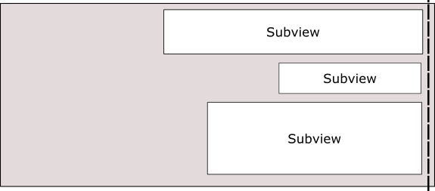
Autolayouts & StackViews
Leading – In a vertically oriented stack view, the leading edges of the subviews are aligned with the leading edge of the stack view.
Trailing - In a vertically oriented stack view, the trailing edges of the subviews are aligned with the trailing edge of the stack view.

Slide 37
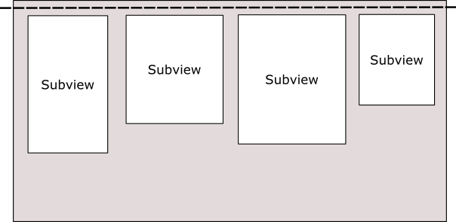
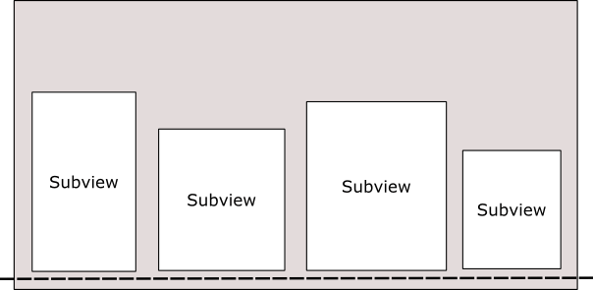
Autolayouts & StackViews
Top – In a horizontally oriented stack view, the top edges of the subviews are aligned with the top edge of the stack view.
Bottom - In a horizontally oriented stack view, the bottom edges of the subviews are aligned with the bottom edge of the stack view.

Slide 38
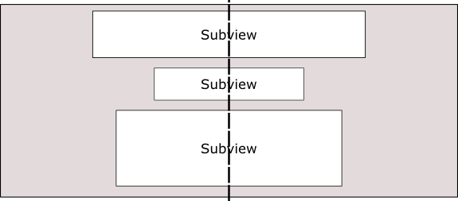
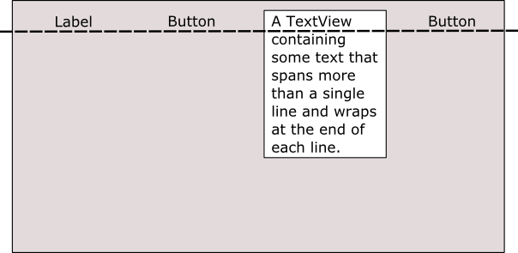
Autolayouts & StackViews
Center – The centers of the subviews are aligned with the center axis of the stack view.
FirstBaseline – Used only with horizontal stack views, this mode aligns all of the subviews with their first baseline. An array of subviews displaying text content, for example, would all be aligned based on the vertical position of the first line of text.

Slide 39
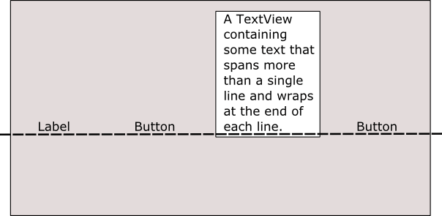
Autolayouts & StackViews
LastBaseline – Similar to FirstBaseline, this mode aligns all of the subviews with their last baseline. For example, an array of subviews displaying text content would all be aligned based on the vertical position of the last line of text.
baseLineRelativeArrangement
Used only for vertical stack views, this property is a Boolean value that controls whether or not the vertical spacing between subviews is arranged relative to the baseline of the text contained within the views.
layoutMarginsRelativeArrangement
A Boolean value which, if set to true, causes subviews to be arranged relative to the layout margins of the containing stack view. If set to false, the subviews are arranged relative to the edges of the stack view.

Slide 40
Autolayouts & StackViews
Creating a Stack View in Code
UIStackView instances can be created in code by passing through an array object containing the subviews to be arranged by the stack. Once created, all of the previously outlined properties may also be set dynamically from within the code. The following Swift code, for example, creates a new stack view object, configures it for horizontal axis orientation with FillEqually distribution and assigns two Label objects as subviews:
let labelOne = UILabel(frame: CGRect(x: 0, y: 0, width: 200, height: 21))
labelOne.text = "Hello"
labelOne.backgroundColor = UIColor.red
let labelTwo = UILabel(frame: CGRect(x: 0, y: 0, width: 200, height: 21))
labelTwo.text = "There"
labelTwo.backgroundColor = UIColor.blue
let myStack = UIStackView(arrangedSubviews: [labelOne, labelTwo])
myStack.distribution = .fillEqually
myStack.axis = .horizontal

Slide 41
Autolayouts & StackViews
Adding Subviews to an Existing Stack View
Additional subviews may be appended to the end of a stack view’s arrangedSubviews array using the addArrangedSubview method as follows:
myStack.addArrangedSubview(labelThree)
Alternatively, a subview may be inserted into a specific index position within the array of arranged subviews via a call to the insertArrangedSubview:atIndex method. The following line of code, for example, inserts an additional label at index position 0 within the arrangedSubviews array of a stack view:
myStack.insertArrangedSubview(labelZero, atIndex: 0)

Slide 42
Autolayouts & StackViews
Hiding and Removing Subviews
To remove an arranged subview from a stack view, call the removeArrangedSubview method of the stack view object, passing through the view object to be removed.
myStack.removeArrangedSubview(labelOne)
It is important to be aware that the removeArrangedSubview method only removes the specified view from the arrangedSubviews array of the stack view. The view still exists in the subviews array and will probably still be visible within the user interface layout after removal (typically in the top left hand corner of the stack view).
An alternative to removing the subview is to simply hide it. This has the advantage of making it easy to display the subview later within the app code. A useful way to hide a subview is to obtain a reference to the subview to be hidden from within the arrangedSubviews array. The following code identifies and then hides the subview located at index position 1 in the array of arranged subviews:
let subview = myStack.arrangedSubviews[1]
subview.hidden = true

Slide 43
Autolayouts & StackViews
If the subview will not be needed again, however, it can be removed entirely by calling the removeFromSuperview method of the subview after it has been removed from the arrangedSubviews array as follows:
myStack.removeArrangedSubview(labelOne)
labelOne.removeFromSuperview()
This approach will remove the view entirely from the view hierarchy.

Slide 44
CONSTRAINTS
Autolayouts & StackViews
There are three ways in which constraints in a user interface layout can be created:
Interface Builder – Interface Builder has been modified extensively to provide support for the visual implementation of Auto Layout constraints in user interface designs.
Visual Format Language – The visual format language defines a syntax that allows constraints to be declared using a sequence of ASCII characters that visually approximate the nature of the constraint being created with the objective of making constraints in code both easier to write and understand.
Writing API code – This approach involves directly writing code to create constraints using the standard programming API calls.

Slide 45
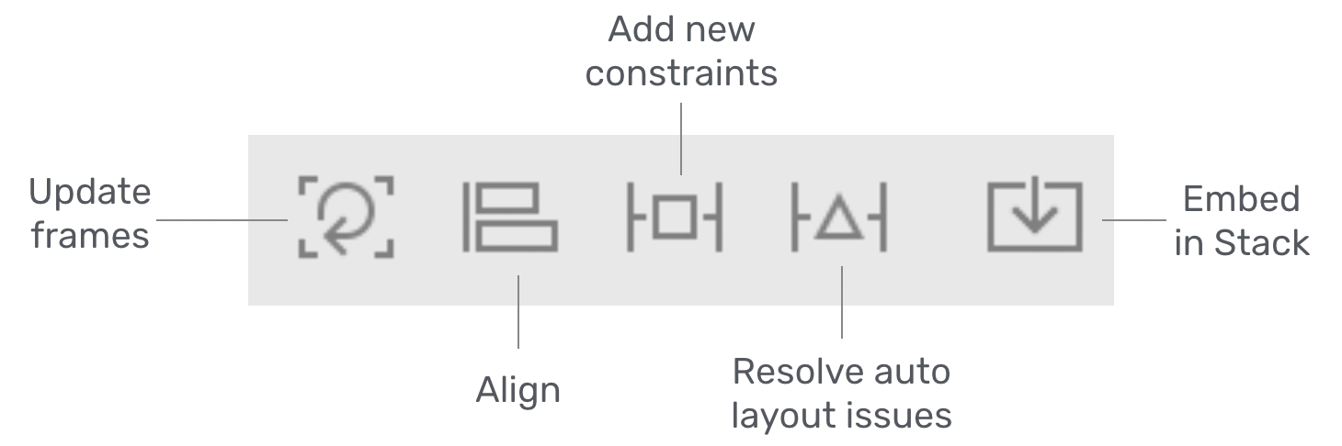
Autolayouts & StackViews
Auto Layout Bar

Slide 46
Autolayouts & StackViews
Each button has its own function:
Align – Create alignment constraints, such as aligning the left edges of two views.
Add new constraints – Create spacing constraints, such as defining the width of a UI control.
Resolve auto layout issues – Resolve layout issue.
Stack – Embed views into a stack view.
Update frames - Update the frame's position and size in reference to the given layout constraints

Slide 47
Alignment Rects
Autolayouts & StackViews
When working with constraints it is important to be aware that constraints operate on the content of a view, not the frame in which a view is displayed. This content is referred to as the alignment rect of the view.
Alignment constraints such as those that cause the center of one view to align with that of another will do so based on the alignment rects of the views, disregarding any padding that may have been configured for the frame of the view.

Slide 48
Intrinsic Content Size
Autolayouts & StackViews
Some views also have what is known as an intrinsic content size. This is the preferred size that a view itself believes it needs to be to display its content to the user.
A Button view, for example, will have an intrinsic content size in terms of height and width that is based primarily on the text or image it is required to display and internal rules on the margins that should be placed around that content.
When a view has an intrinsic content size, Auto Layout will automatically assign two constraints for each dimension for which the view has indicated an intrinsic content size preference (i.e. height and/or width). One constraint is intended to prevent the size of the view becoming larger than the size of the content (otherwise known as the content hugging constraint).
The other constraint is intended to prevent the view from being sized smaller than the content (referred to as the compression resistance constraint).

Slide 49
Autolayouts & StackViews
Content Hugging and Compression Resistance Priorities
The resize behaviour of a view with an intrinsic content size can be controlled by specifying compression resistance and content hugging priorities.
A view with a high compression resistance priority and a low content hugging priority will be allowed to grow but will resist shrinking in the corresponding dimension.
Similarly, a high compression resistance priority in conjunction with a high content hugging priority will cause the view to resist any form of resizing, keeping the view as close as possible to its intrinsic content size.

Slide 50
Auto Layout Features Of Interface Builder
Autolayouts & StackViews
A number of features are provided in Xcode in order to assist in the implementation of Auto Layout based constraints. This section will present a guided tour of many of these features.
Suggested Constraints
Visual Cues.
Highlighting Constraints Problems.
Viewing, Editing & Deleting Constraints

Slide 51
Autolayouts & StackViews
Suggested Constraints
When objects are added to a layout canvas, Interface Builder does not implement any default constraints on those views leaving the developer to add constraints as needed, the option to have Interface Builder apply suggested constraints.
When this option is used, Interface Builder will apply what it believes to be the correct constraints for the layout based on the positioning of the views.
Suggested constraints can be added either to the currently selected view objects, or to an entire scene layout.
In situations where constraints are missing from a layout resulting in warnings, Interface Builder also provides the option to automatically add the constraints that it believes are missing

Slide 52
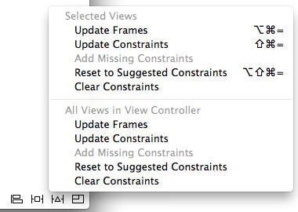
Autolayouts & StackViews
The options to perform these tasks are accessed via the Resolve Auto Layout Issues menu in the toolbar as illustrated in above Figure.
The top section of the menu represents tasks that relate to the currently selected views in the canvas, while the options in the lower section apply to all views in the currently selected view controller scene.

Slide 53
Autolayouts & StackViews
Most of the time, the suggested constraints will exactly match the required layout behavior and occasionally, the suggested constraints will be incorrect. Most of the time, however, the suggested constraints provide an excellent starting point for implementing Auto Layout.
A typical process for designing a user interface might, therefore, involve positioning the views by dragging and dropping them into place, applying suggested constraints and then editing and fine tuning those constraints to perfect the layout.

Slide 54
Autolayouts & StackViews
2. Visual Cues
Interface Builder includes a number of visual cues in the layout canvas to highlight the constraints currently configured on a view and to draw attention to areas where problems exist.
When a view is selected within the layout canvas, the constraints that reference that view will be represented visually.
Consider, for example, the label view created in our AutoLayoutExample application. When selected in the canvas, a number of additional lines appear as shown in Figure.

Slide 55
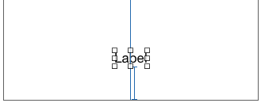
Autolayouts & StackViews
The vertical line that runs through the center of the label indicates the presence of a constraint that positions the label in the horizontal center of the parent view (analogous to the NSLayoutAttribute.CenterX attribute). If expressed as an equation, therefore, this would read as:
label.NSLayoutAttribute.CenterX = superview.NSLayoutAttribute.CenterX
The I-beam line running from the bottom edge of the label view to the bottom edge of the parent view indicates that a vertical space constraint is in place between the two views.

Slide 56

Autolayouts & StackViews
3. Highlighting Constraints problems
Interface Builder also uses a range of visual cues and decorations to indicate that constraints are either missing, ambiguous or in conflict.Valid and complete Auto Layout configurations are drawn using blue lines. When part of a layout is ambiguous the constraint lines are orange.
Ambiguity typically occurs when a constraint is missing.
for example, Below image illustrates a conflict where one constraint is attempting to set the width of a view to 110 points while a second constraint dictates that the width must be greater than or equal to 120 points:

Slide 57

Autolayouts & StackViews
4. Viewing, Editing & Deleting Constraints
All of the constraints currently set on the views of a user interface may be viewed at any time from within the Document Outline panel that is positioned to the left of the Interface Builder canvas area.
Hidden by default, this panel can be displayed by clicking on the button in the bottom left-hand corner of the storyboard canvas.

Slide 58
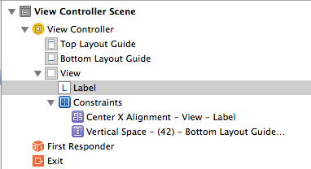
Autolayouts & StackViews
Within this outline, a category listed as Constraints will be present which, when unfolded, will list all of the constraints currently configured for the layout.
Note that when more than one container view is present in the view hierarchy there will be a separate constraints list for each one.

Slide 59
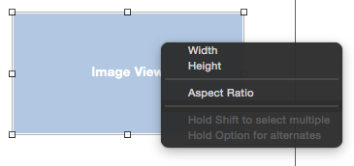
Aspect Ratio Constraints
Autolayouts & StackViews
The height and width of a view can be constrained to retain aspect ratio by Ctrl-clicking in the view, dragging diagonally and then releasing.
In the resulting menu, selecting Aspect Ratio ensures that regardless of whether the view shrinks or grows, the current aspect ratio will be retained.

Slide 60
Size Classes
Autolayouts & StackViews
What are Size Classes?
In iOS, Size Classes are groups of screen sizes that are applied to the width and height of the device screen. The two Size Classes that exist currently are Compact and Regular.
The Compact Size Class refers to a constrained space. It is denoted in Xcode as wC (Compact width) and hC (Compact height).
The Regular Size Class refers to a non-constrained space. It is denoted in Xcode as wR (Regular width) and hR (Regular height

Slide 61
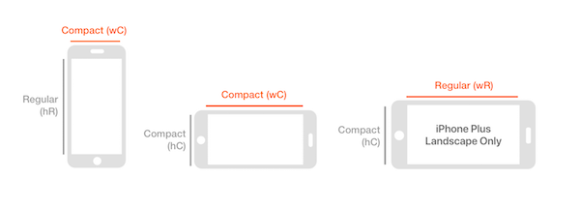
Autolayouts & StackViews
iPhone
Most iPhone devices will use the Compact width (wC) size class in each orientation with some exceptions

Slide 62
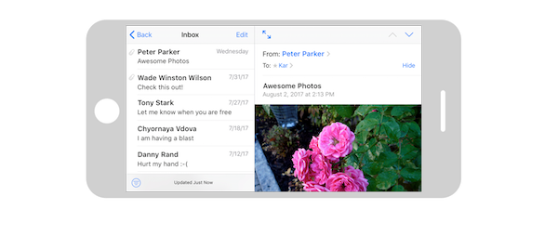
Autolayouts & StackViews
The iPhones 6/7 Plus can inherit the Regular width (wR) size class resulting in the ability to use functionality normally reserved for the iPad, such as the split-view pane.
For instance, using the Mail application on an iPhone 7 Plus in horizontal landscape will cause a split-view pane to appear, allowing the user to better utilize the available space rather than just displaying a single table view.

Slide 63
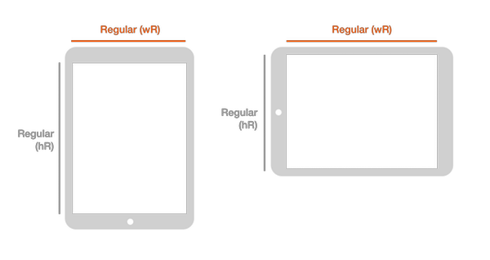
Autolayouts & StackViews
iPad
All iPad devices use the Regular width (wR) size class regardless of landscape or portrait orientation. In both horizontal and vertical landscape, the iPad will use a split-view pane to take advantage of the available screen space because it falls within this unconstrained size class.

Slide 64
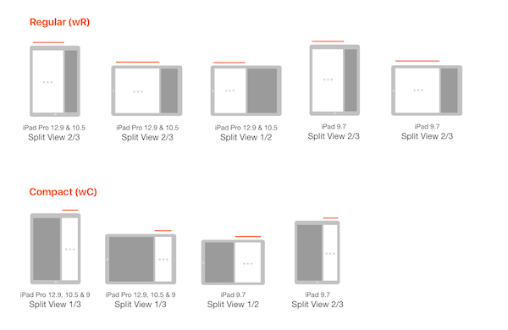
Autolayouts & StackViews
Multitasking on iPad: Split View and Slide Over
Split-View multitasking and Slide Over allow your app can share a screen with another app in a 1/2, 1/3 or 2/3 ratio in either landscape or portrait orientation.
Depending on the ratio, the operating system will either display the Compact width (wC) or Regular width (wR) layout.

Slide 65
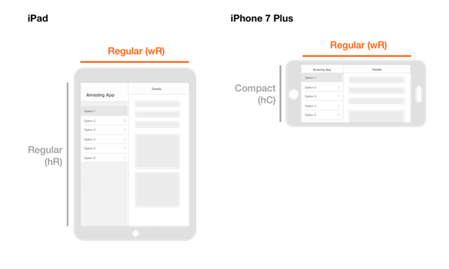
Autolayouts & StackViews
Controlling the UI with Size Classes
In most cases, specifying the width class is sufficient when laying out your app; however, you can use the height class to customize your app as well.
For example, if you use a split-view pane in an iPad app, users will see the same pane on iPhone Plus in landscape orientation because they both inherit the Regular width (wR) size class.

Slide 66
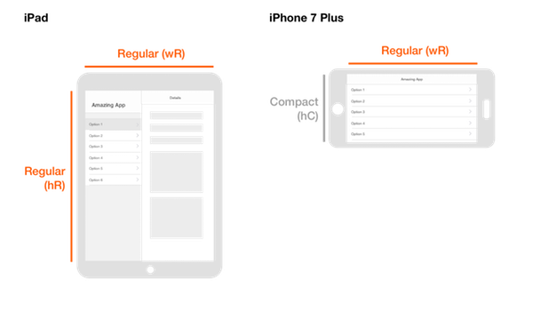
Autolayouts & StackViews
If that is not your intention, you can exclude a split-view pane from appearing on the 7 Plus by specifying both the width and height Size Classes. This works because the height of an iPhone Plus in landscape orientation is compact (hC) while all iPad devices have a regular height (hR).
Understanding Size Classes allows you the flexibility to meet your user’s needs regardless of which device they use. I encourage you to explore how Xcode handles Size Classes to understand the possibilities at your disposal.

Slide 67
Autolayouts & StackViews
Assignment
Develop an iOS Application & How to use Auto Layout Features?

Slide 68
Autolayouts & StackViews
Document Links
Topics | URL | Notes
Introduction to Auto Layouts Constraints Alignment Rect Content Size | https://www.appcoda.com/learnswift/auto-layout-intro.html https://www.techotopia.com/index.php/An_Introduction_to_Auto_Layout_in_iOS_8 | This link explains the Testing Fundamentals and Testing App on Real Device.
5. Auto Layouts Features 6. Visual Cues 7. Aspect Ratio Constraints 8. Size Classes | https://www.techotopia.com/index.php/Working_with_iOS_8_Auto_Layout_Constraints_in_Interface_Builder https://www.bignerdranch.com/blog/designing-for-size-classes-in-ios/ | This link explains Preparing and Publishing App to the Appstore.

Slide 69
Autolayouts & StackViews
E-Book Links
https://www.appcoda.com/learnswift/auto-layout-intro.html
https://www.techotopia.com/index.php/An_Introduction_to_Auto_Layout_in_iOS_8
https://www.techotopia.com/index.php/Working_with_iOS_8_Auto_Layout_Constraints_in_Interface_Builder
https://www.bignerdranch.com/blog/designing-for-size-classes-in-ios/

